Slide 1

Hospital
Adam

Slide 2

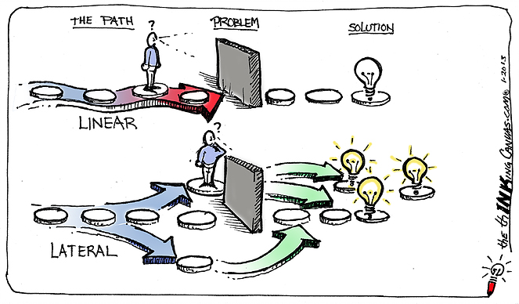
You should possess super powers
You should possess lateral thinking

Slide 3

Tech-Know School Machine Learning 1-0-1 : Boot Camp
Raja Ram Kankipati, SAP
May 27, 2019

Slide 4


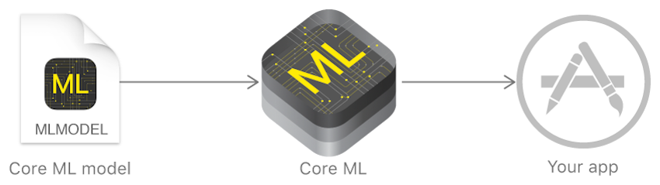

Data Science Project in a Nutshell
Raw Data
Data Cleaning
Machine Learning Model
Supervised
Linear Regression
Unsupervised
Clustering
Logistic Regression
Decision Trees
Data
Numeric
Continuous
Age
Discrete
#houses
Categorical
Nominal
Gender
Ordinal
Quality
Missing Data (Imputation)
Standardization (Normality)
Encoding (Dummies)
EDA, Feature Enginerring
Visualization

Slide 5



How to train your Model
Choose a model
Split data in to Train, Validation, Test
Fit
Using Training and Cross validation error find the hyper parameters
Predict
Using Test data evaluate the performance on unseen data
Model
Model
Model

Slide 6
How to select your model
Get more data
Start
Classification
> 50 samples
Predicting a category
Do you have labelled data
Regression
Predicting a quantity
Clustering
BACK

Slide 7
Thank you.
Partner logo

